Slide 1
_{Ways To Minimize Air Pollution}
Stopping The Irrevocable

Slide 2
Activated Carbon
activated carbon In adsorption, gaseous pollutants are removed from an air stream by transferring the pollutants to the solid surface of an adsorbent. Activated carbon is the most commonly used adsorbent, although zeolites, polymers, and other adsorbents may be used. There is a limit to the mass of pollutants that can be collected by an adsorbent. When this limit is reached, the adsorbent is no longer effective in removing pollutant. To recover the ability to capture gaseous pollutants, adsorbents typically are "regenerated;" i.e., the pollutant is desorbed (removed) from the adsorbent. This regeneration may occur off-site or on-site. (A special case of on-site regeneration occurs when the adsorbent is used to concentrate pollutants for on-site thermal or catalytic oxidation. These concentrators are discussed separately and can be accessed by clicking on the link provided below.)

Slide 3
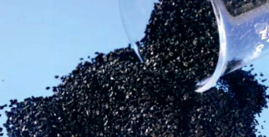
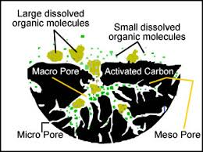
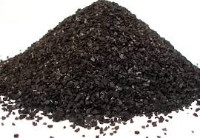

Slide 4
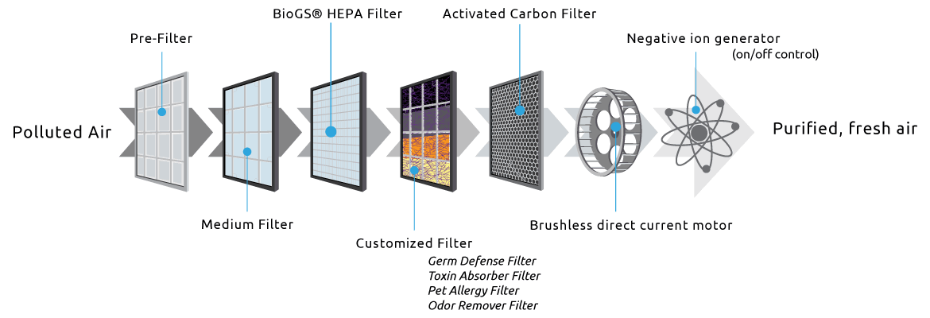
Bio Filtration

Slide 5
Catlytic Oxidizers
To reduce fuel usage required for oxidation, catalytic oxidizers may have some form of heat recovery. The percentage of heat recovery in the design of catalytic oxidizers generally increases with decreasing inlet VOC/HAP concentration. Heat recovery may either be regenerative or recuperative. In regenerative heat recovery, hot exhaust gases and cool inlet gases are alternatively passed through a fixed bed, typically employing ceramics. In recuperative heat recovery, heat is recovered by passing the hot exhaust gases through a non-contact air-to-air heat exchanger to heat incoming air to the oxidizer.
A training tool developed for inspectors provides an overview of oxidizers, including catalytic oxidizers; this tool describes oxidizer types, operating principles, pollutants controlled, proper operating conditions, and performance monitoring of oxidizers. A training video provides similar information in an audio-video format (about 15 minutes in length). Other specific information about catalytic oxidizers can be found from the EPA Air Pollution Control Cost Manual, Section 3.2, Chapter 2 - Incinerators and from the EPA Fact Sheet - Catalytic Incinerator.

Slide 6
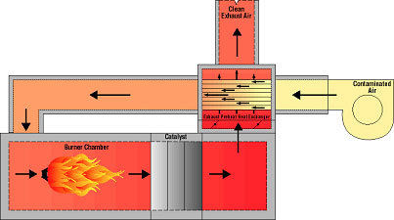

Slide 7
Dry Scrubbers
Scrubbers are devices that use a liquid (often water) to capture and remove pollutants. Through a nozzle or orifice a scrubbing liquid is atomized and dispersed into the gas stream. The droplets entrain and capture dust particles through agglomeration, adherence, or encapsulation. This effectively increases the size and mass of the particles, making them easier to collect in a subsequent filter or separation process. The scrubbing liquid simultaneously absorbs and neutralizes gaseous pollutants. Suspended liquid is typically recovered in mist collectors and recycled through the system.

Slide 8
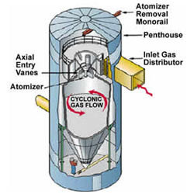
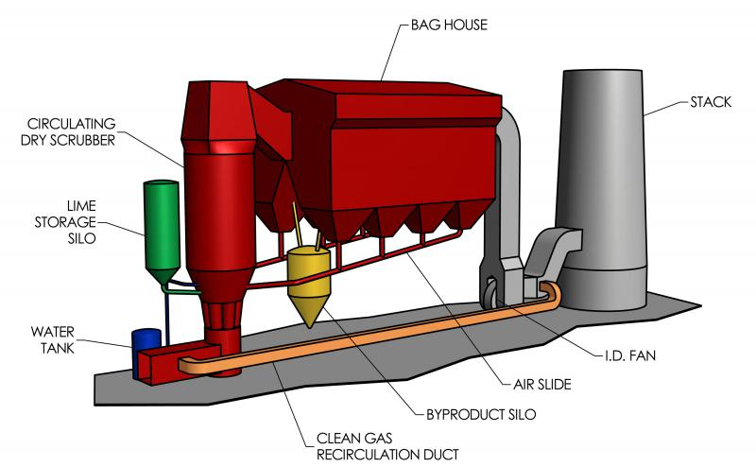

Slide 9
THANK YOU BY GAURAV NOTANEY & VAIBHAV SHARMA

